Slide 1
Searching

Slide 2
Searching
In computer science, searching is the process of finding an item with specified properties from a collection of items.
The items may be stored as records in a database, simple data elements in arrays, text in files, nodes in trees, vertices and edges in graphs, or they may be elements of other search spaces.

Slide 3
Types of searching
Linear Search
Binary Search
Interpolation search

Slide 4
Linear search
LINEAR_SEARCH(A, N, VAL)
Step 1: [INITIALIZE] SET POS = -1
Step 2: [INITIALIZE] SET I = 1
Step 3: Repeat Step 4 while I<=N
Step 4: IF A[I] = VAL
SET POS = I
PRINT POS
Go to Step 6
[END OF IF]
[END OF LOOP]
Step 6: EXIT
SET I = I + 1
Step 5: IF POS = –1
PRINT VALUE IS NOT PRESENT
IN THE ARRAY
[END OF IF]

Slide 5
Binary search
BINARY_SEARCH(A, lower_bound, upper_bound, VAL)
Step 1: [INITIALIZE] SET BEG = lower_bound
END = upper_bound, POS = - 1
Step 2: Repeat Steps 3 and 4 while BEG <= END
Step 3: SET MID = (BEG + END)/2
Step 4: IF A[MID] = VAL
SET POS = MID
PRINT POS
Go to Step 6
ELSE IF A[MID] > VAL
SET END = MID - 1
ELSE
SET BEG = MID + 1
[END OF IF]
[END OF LOOP]
Step 5: IF POS = -1
PRINT “VALUE IS NOT PRESENT IN THE ARRAY”
[END OF IF]
Step 6: EXIT

Slide 6
Interpolation search
INTERPOLATION_SEARCH (A, lower_bound, upper_bound, VAL)
Step 1: [INITIALIZE] SET LOW = lower_bound,
HIGH = upper_bound, POS = –1
Step 2: Repeat Steps 3 to 4 while LOW <= HIGH
Step 3: SET MID = LOW + (HIGH – LOW) ×
((VAL – A[LOW]) / (A[HIGH] – A[LOW]))
Step 4: IF VAL = A[MID]
POS = MID
PRINT POS
Go to Step 6
ELSE IF VAL < A[MID]
SET HIGH = MID – 1
ELSE
SET LOW = MID + 1
[END OF IF]
[END OF LOOP]
Step 5: IF POS = –1
PRINT "VALUE IS NOT PRESENT IN THE ARRAY"
[END OF IF]
Step 6: EXIT

Slide 7
Hashing

Slide 8
What is a hashing?
Hashing is a technique used for storing and retrieving information as quickly as possible. It is used to perform optimal searches and is useful in implementing symbol tables.

Slide 9
Components of Hashing
Hash Table
Hash Functions
Collisions
Collision Resolution Techniques

Slide 10
Hash Table
Hash table is a data structure in which keys are mapped to array positions by a hash function.
Hash table is a generalization of array. With an array, we store the element whose key is k at a position k of the array.
That means, given a key k, we find the element whose key is k by just looking in the kth position of the array. This is called direct addressing.

Slide 11
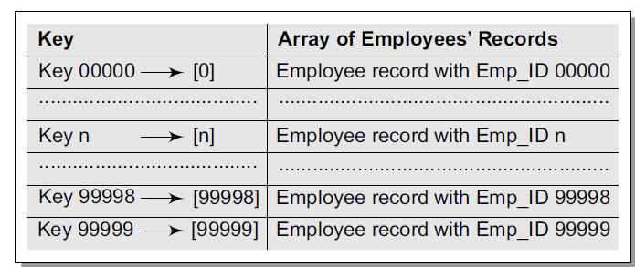
Records of employees with a five-digit Emp_ID

Slide 12
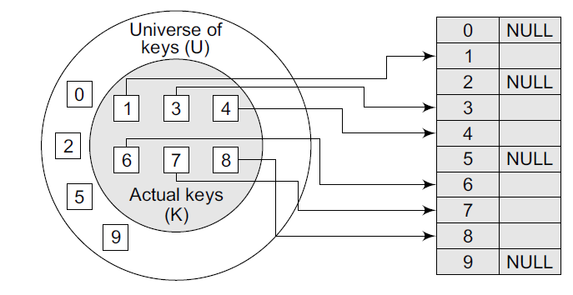
Direct relationship between key and index in the array

Slide 13
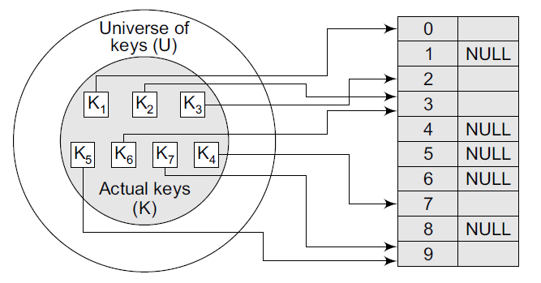
Relationship between keys and hash table index

Slide 14
The common operations for hash table
CreatHashTable: Creates a new hash table
HashSearch: Searches the key in hash table
Hashlnsert: Inserts a new key into hash table
HashDelete: Deletes a key from hash table
DeleteHashTable: Deletes the hash table

Slide 15
Hash Function
A hash function is a mathematical formula which, when applied to a key, produces an integer which can be used as an index for the key in the hash table.
The main aim of a hash function is that elements should be relatively, randomly, and uniformly distributed. It produces a unique set of integers within some suitable range in order to reduce the number of collisions.
In practice, there is no hash function that eliminates collisions completely. A good hash function can only minimize the number of collisions by spreading the elements uniformly throughout the array.

Slide 16
Different Hash functions
Division Method
Multiplication Method
Mid-Square Method
Folding Method

Slide 17
Division Method
It is the most simple method of hashing an integer x. This method divides x by M and then uses the remainder obtained. In this case, the hash function can be given as:
h(x) = x mod M
The division method is quite good for just about any value of M and since it requires only a single division operation, the method works very fast. However, extra care should be taken to select a suitable value for M
Generally, it is best to choose M to be a prime number because making M a prime number increases the likelihood that the keys are mapped with a uniformity in the output range of values.

Slide 18
Multiplication Method
The steps involved in the multiplication method are as follows:
Step 1: Choose a constant A such that 0 < A < 1.
Step 2: Multiply the key k by A.
Step 3: Extract the fractional part of kA.
Step 4: Multiply the result of Step 3 by the size of hash table (m).
Hence, the hash function can be given as:
h(k) = Floor( m (kA mod 1))

Slide 19
Mid-Square Method
The mid-square method is a good hash function which works in two steps:
Step 1: Square the value of the key. That is, find k^2.
Step 2: Extract the middle r digits of the result obtained in Step 1.
In the mid-square method, the same r digits must be chosen from all the keys.

Slide 20
Folding Method
The folding method works in the following two steps:
Step 1: Divide the key value into a number of parts. That is, divide k into parts k1, k2, ..., kn, where each part has the same number of digits except the last part which may have lesser digits than the other parts.
Step 2: Add the individual parts. That is, obtain the sum of k1 + k2 + ... + kn. The hash value is produced by ignoring the last carry, if any.

Slide 21
Characteristics of good Hash Functions
Minimize collision
Be easy and quick to compute
Distribute key values evenly in the hash table
Use all the information provided in the key
Have a high load factor for a given set of keys
The load factor of a non-empty hash table is the number of items stored in the table divided by the size of the table. This is the decision parameter used when we want to rehash or expand the existing hash table entries. This also helps us in determining the efficiency of the hashing function.

Slide 22
Collisions
Collisions occur when the hash function maps two different keys to the same location.
Two records cannot be stored in the same location. Therefore, a method used to solve the problem of collision, also called collision resolution technique, is applied.
The two most popular methods of resolving collisions are:
1. Direct Chaining
2. Open addressing

Slide 23
Direct Chaining
An array of linked list application
Separate chaining
Collision resolution by chaining combines linked representation with hash table. When two or more records hash to the same location, these records are constituted into a singly-linked list called a chain.

Slide 24
Open Addressing
In open addressing all keys are stored in the hash table itself. This approach is also known as closed hashing. This procedure is based on probing. A collision is resolved by probing.
Linear probing (linear search)
Quadratic probing (nonlinear search)
Double hashing (use two hash functions)

Slide 25
Linear probing
In linear probing, we search the hash table sequentially, starting from the original hash location.
If a location is occupied, we check the next location. We wrap around from the last table location to the first table location if necessary. The function for rehashing is the following:
rehash(key) = (n + 1)% tablesize
One of the problems with linear probing is that table items tend to cluster together in the hash table

Slide 26
Quadratic Probing
In quadratic probing, we start from the original hash location i.
If a location is occupied, we check the locations i + 1^2 , i +2^2, i + 3^2, i + 4^2... The function for rehashing is the following:
rehash(key) = (n + k^2)% tablesize
Even though clustering is avoided by quadratic probing, still there are chances of clustering.

Slide 27
Double Hashing
We first probe the location h1(key). If the location is occupied, we probe the location h1(key) + h2(key), h1(key) + 2 * h2(key),

